Slide 1
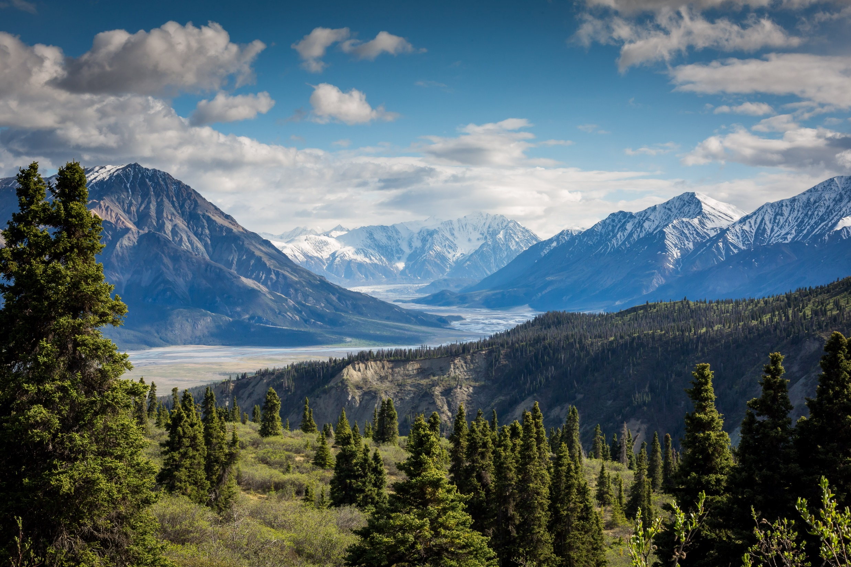
Components of biodiversity along altitudinal gradients
Photo by Kalen Emsley on Unsplash

Slide 2
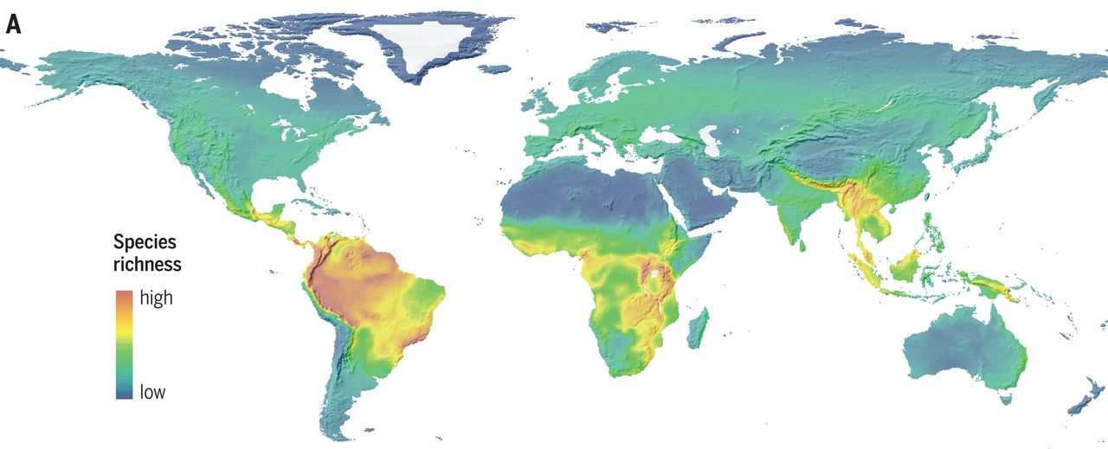
Why study biodiversity in mountains?
large environmental gradients in a relatively small geographical area
Biodiversity hotspots. “Mountain regions host roughly 87% of the world’s species of amphibians, birds, and mammals while constituting only around 25% of terrestrial land mass (excluding Antarctica)” (Rahbek, 2019)
High endemism
Refugia during periods of climate change
High speciation rates (e.g. due to fragmentation)
strongly affected by global changes
Species richness of birds, mammals, amphibians (Rahbek, 2019)

Slide 3
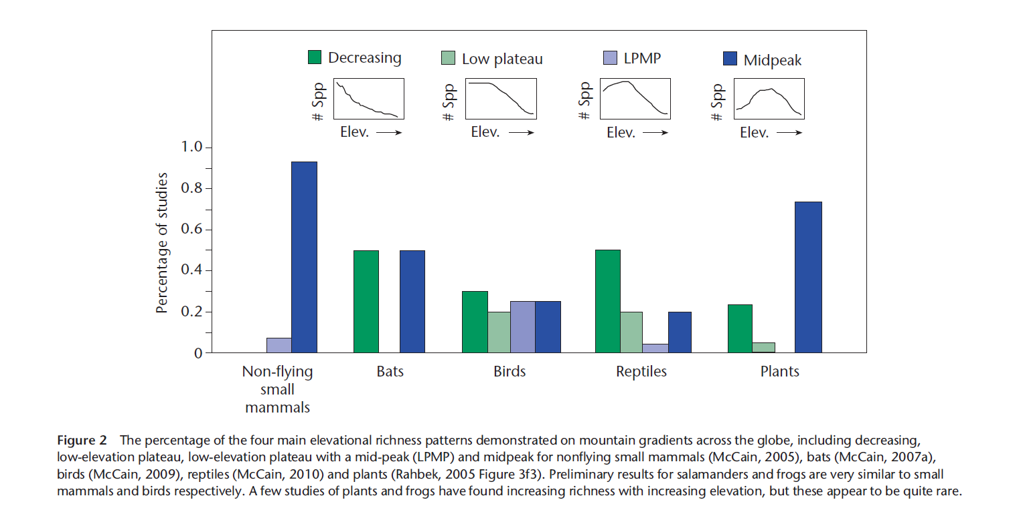

Slide 4
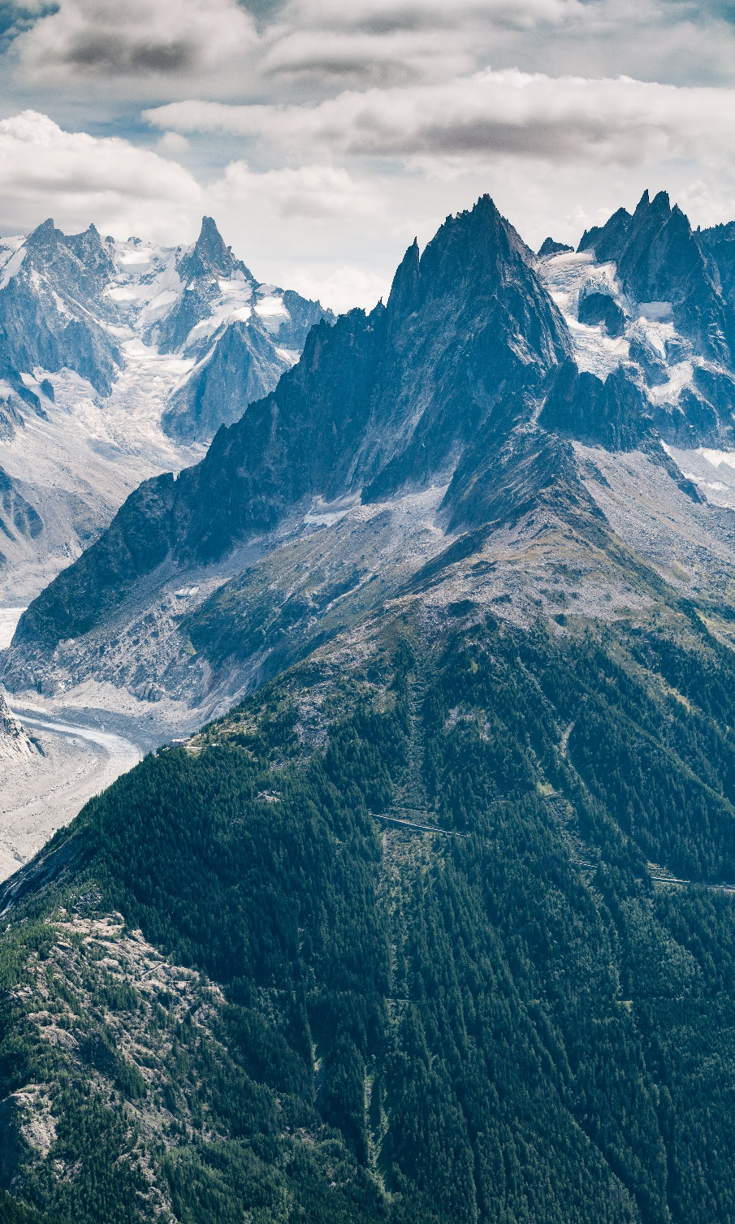
Components of biodiversity along elevational gradients
Rather than species richness at a single scale:
Changes in number of individuals
Changes in Species abundance distribution (SAD)
Requirement: abundance data (site-by-species matrix)

Slide 5

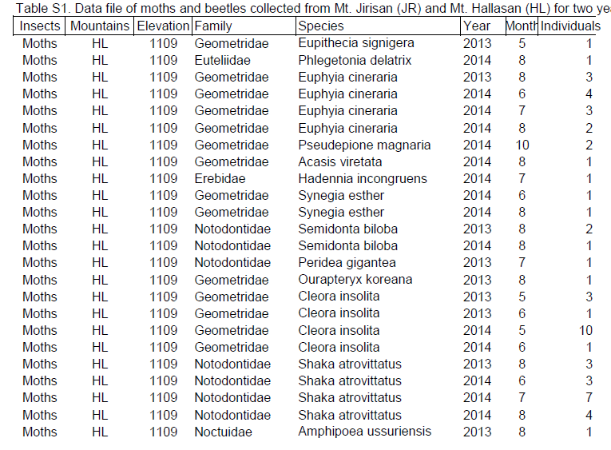
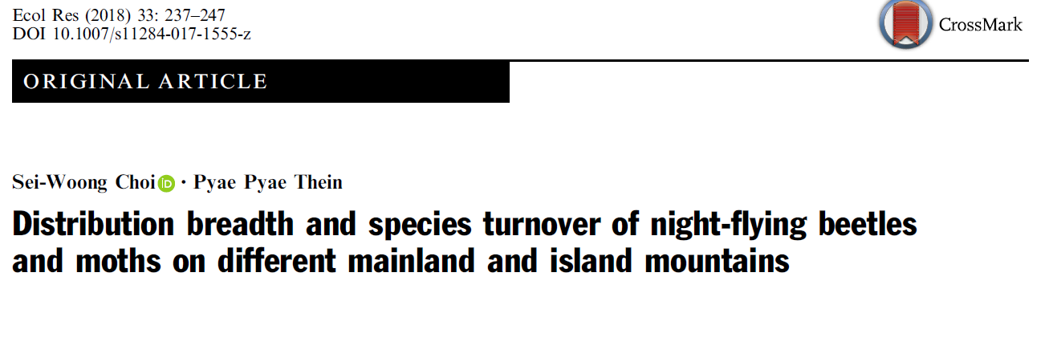
Extracting data from the literature
Analysis!

